Slide 1
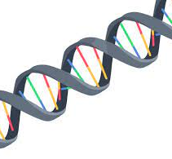
MOLECULAR BIOLOGY
Chapters 12, 13, & 14

Slide 2
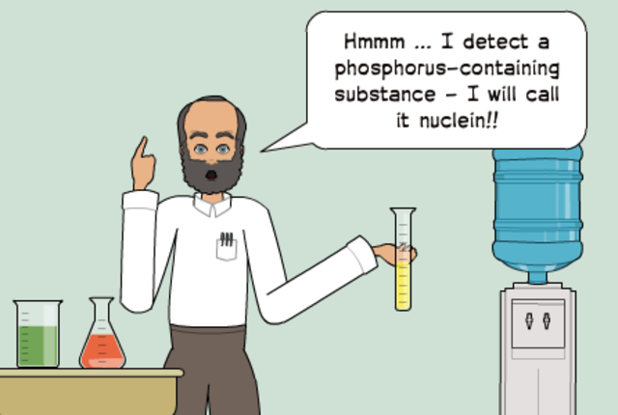
JOHANN FRIEDRICH MIESCHER 1844-1895
Swiss physician and biochemist
Researched lymphatic cells
Hard to extract from lymph glands
Easy to obtain from pus of open wounds
Isolated a new molecule "nuclein"
Large molecule
Made of hydrogen, oxygen, nitrogen, & phosphorus
Unique ratio of phosphorus to nitrogen

Slide 3
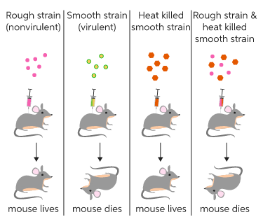

FREDERICK GRIFFITH 1879-1941
British bacteriologist
Discovered living, harmless bacteria can be transformed into harmful bacteria
Genetic information must have been passed from one strain to other
Identified the Transformation Principle
Genetic info transferred from nonliving cells to living cells; picked up from environment
Living cells transform to exhibit traits of nonliving cell

Slide 4
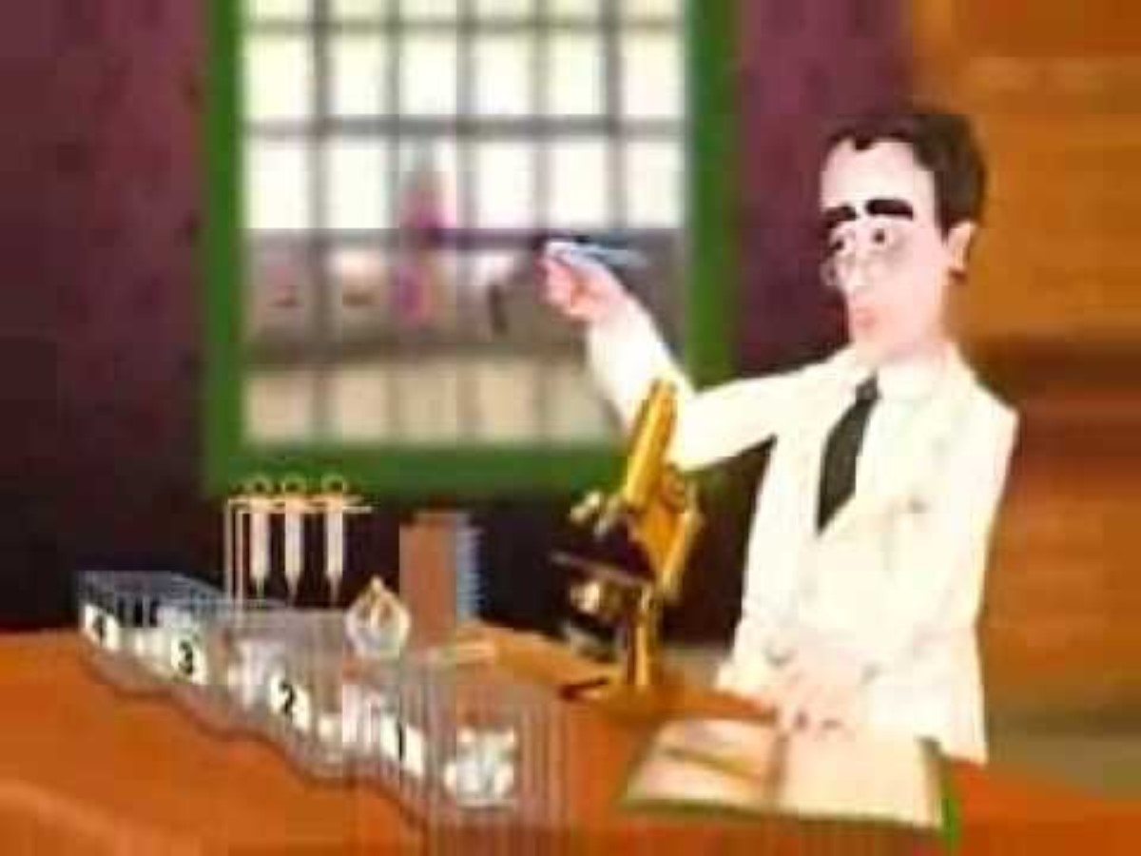
VIDEO – GRIFFITH'S EXPERIMENT

Slide 5
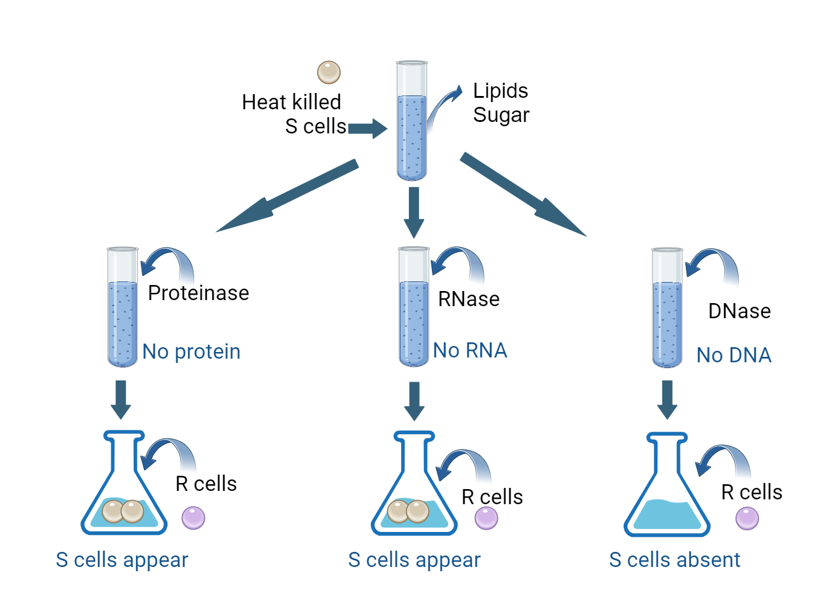
AVERY, MACLEOD, and MCCARTY 1944
Oswald Avery – Canadian physician
Colin MacLeod – Canadian physician
Maclyn McCarty – American bacteriologist
Skeptical of Griffith's results – set out to replicate results
Discovered that transformation could not occur in absence of DNA
Transformation Principle must be DNA (DeoxyriboNucleic Acid)
DNA must be hereditary material

Slide 6
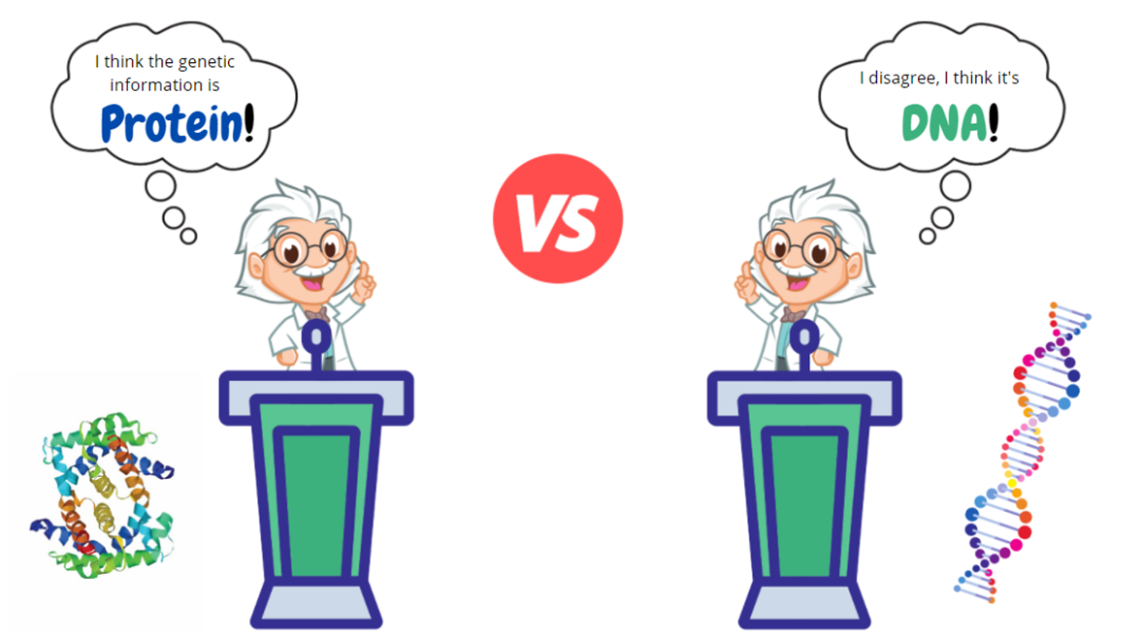
DNA vs PROTEIN DEBATE Prior to 1950s
Despite previous discoveries, much debate over the composition of genetic material
Was understood that genetic material must be highly variable to account for all our differences
However, previous research (Meischer) indicated that genetic material must also have similar, uniform structure
Two sides of debate:
Protein – made from 20 different amino acids – highly variable
DNA – made from 4 nucleotides – uniform structure

Slide 7
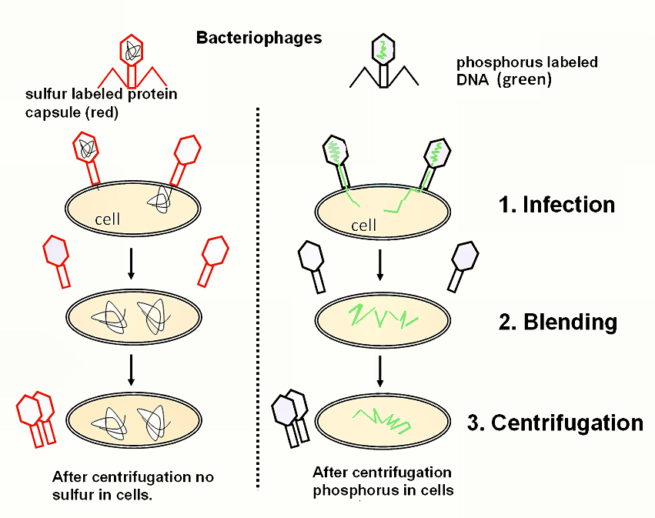
HERSHEY & CHASE 1952
Explored genetic pathways of bacteria & bacteriophages
Bacteriophage – virus only infects bacteria
Used radioactivity to label the molecules
Determined:
Phage protein remained outside the host cell
Phage DNA entered the host cell
Concluded that DNA is the genetic material, not protein

Slide 8
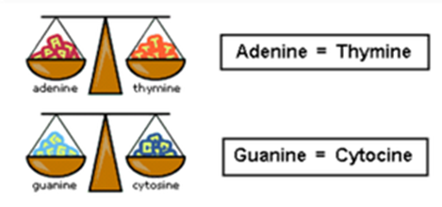
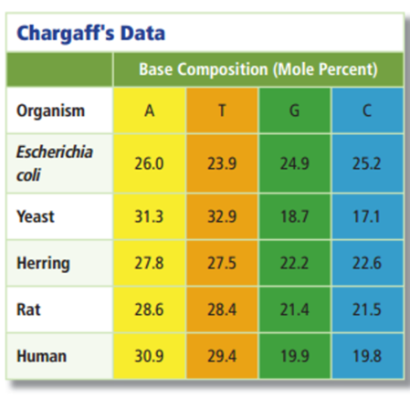
ERWIN CHARGAFF 1905-2002
American biochemist
Discovered that amount of guanine and cytosine bases are equal in any sample of DNA
Same must be true for adenine and thymine
Chargaff's Rule:
C = G and A = T
After further investigation, developed Chargaff's Second Rule:
The composition of DNA remains relatively constant within a species but varies from one species to another.

Slide 9
CHARGAFF'S RULE - PRACTICE
A segment of DNA has 120 adenine nucleotides and 120 cytosine nucleotides. What is the total number of nucleotides? What percent of the total is each nucleotide?

Slide 10
CHARGAFF'S RULE - PRACTICE
The combined guanine/cytosine content of a DNA strand is found to be 60%. What percent of the strand is each of the 4 nucleotides?

Slide 11
CHARGAFF'S RULE - PRACTICE
In a DNA molecule that has 180 base pairs, 20% of the nucleotides are found to be adenine. How many cytosine nucleotides are present in the same DNA molecule?

Slide 12
CHARGAFF'S RULE - PRACTICE
In a DNA molecule, 880 guanine nucleotides are found, which account for 22% of the total number of nucleotides. Determine the total length of the DNA molecule, as well as the number of the other three nucleotides.

Slide 13
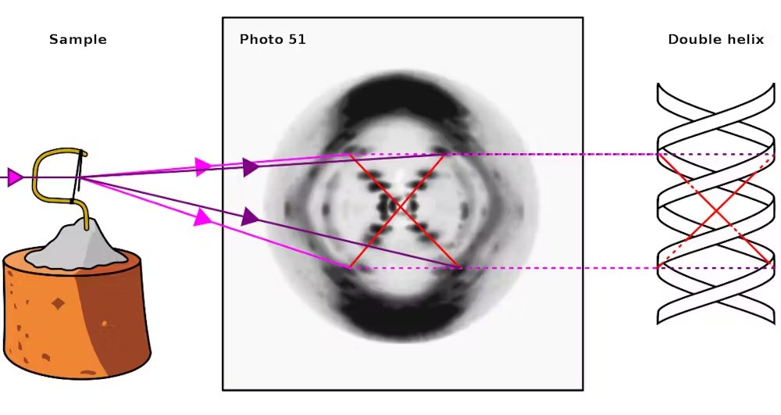
ROSALIND FRANKLIN 1920-1958
English chemist & x-ray crystallographer
Worked at King's College in London
Using x-ray crystallography, she determined that DNA molecule is a sort of helix
Discovery was vital in understanding DNA structure
Fought ovarian cancer for 2 years before death at age 37. Continued to work until 2 weeks before her passing.

Slide 14
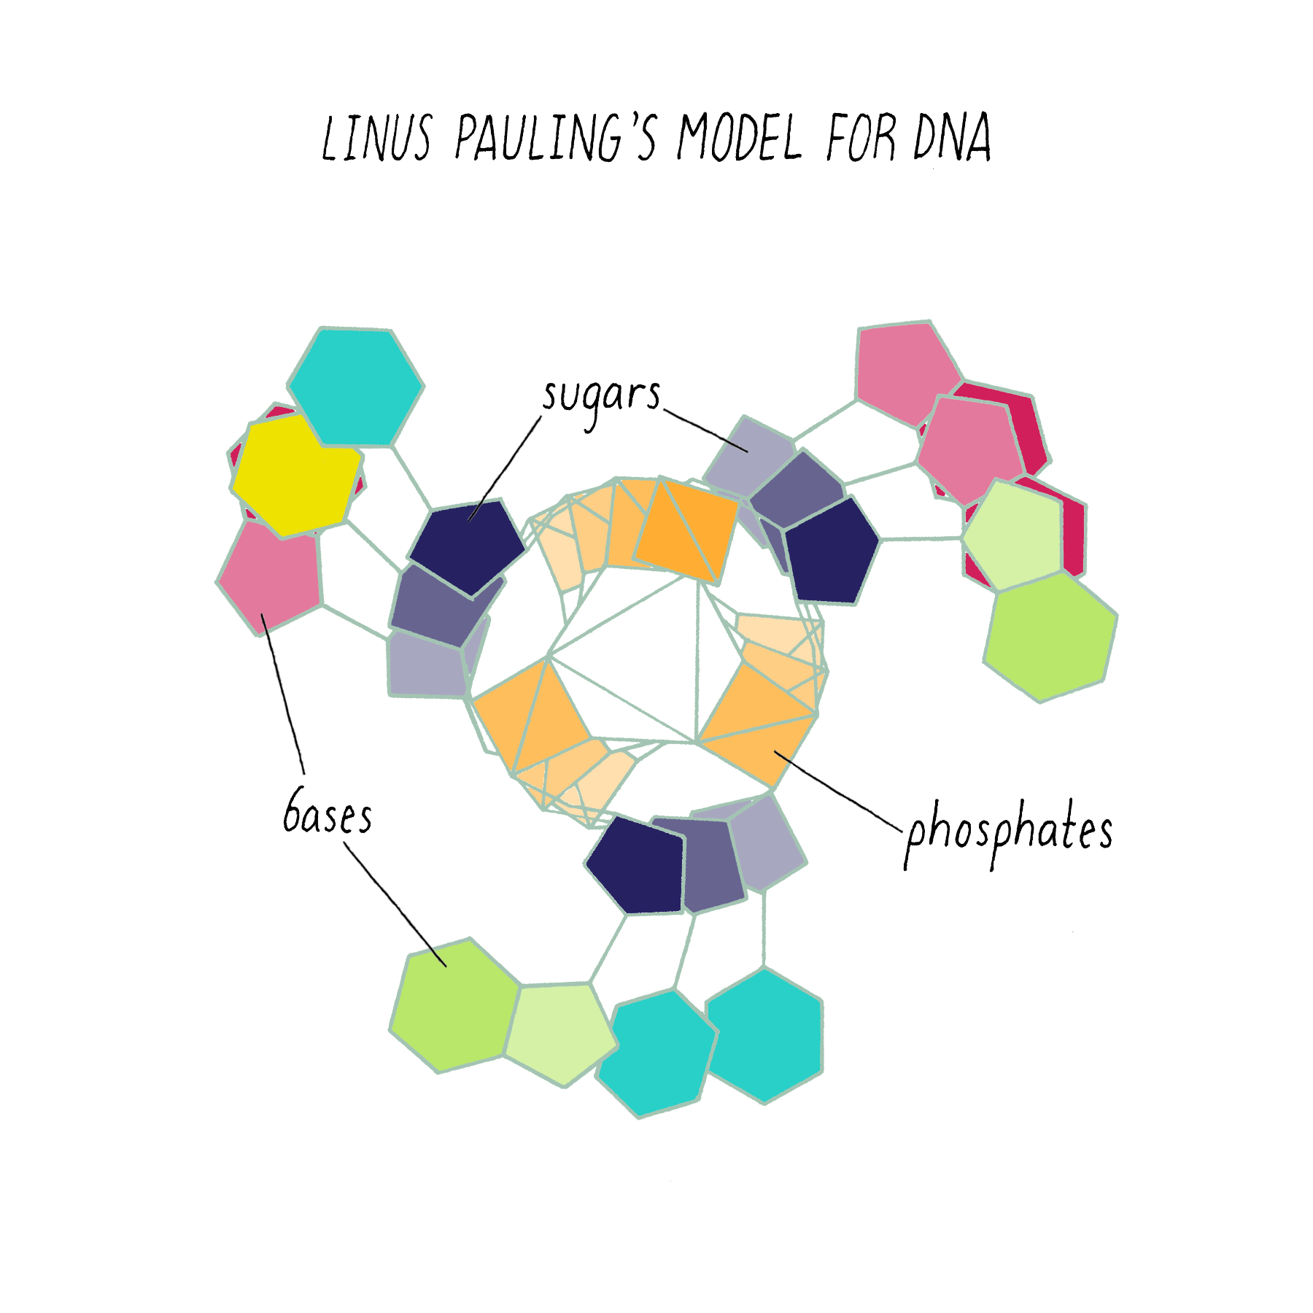
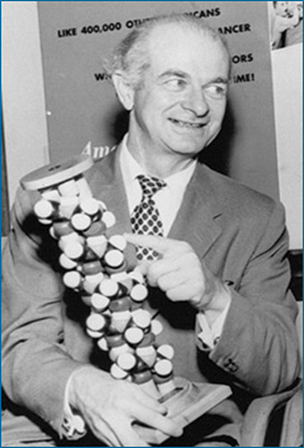
LINUS PAULING 1901-1994
American chemist
Proposed first DNA model using mathematical reasoning
One of only 2 individuals to receive Nobel Prize in more than one field – Chemistry and Peace
Other person was Marie Curie – Chemistry and Physics
Only individual to earn 2 unshared Nobel Prizes

Slide 15
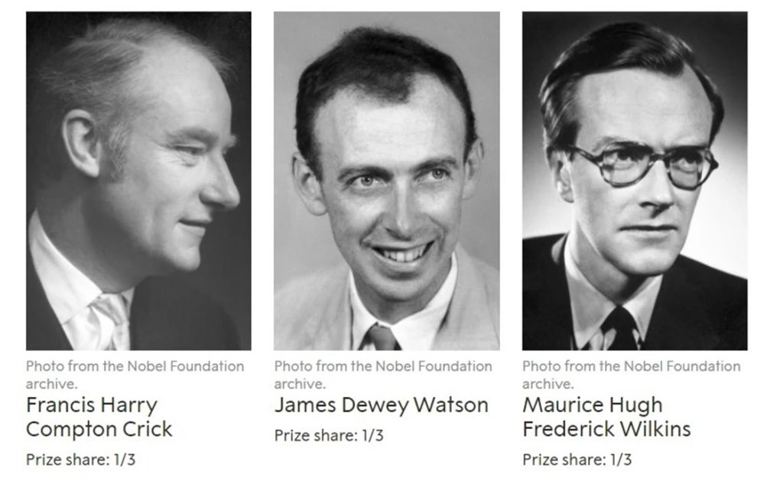
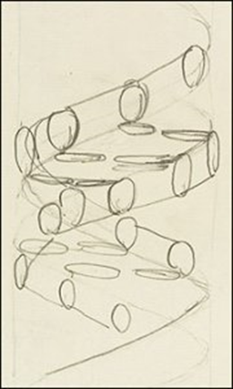
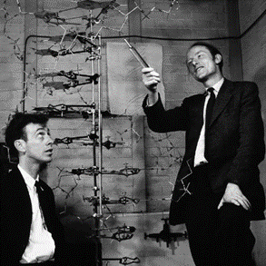
WATSON & CRICK February 28, 1953
Solved the structure of DNA
Model accepted and used today
Wilkins was colleague of Rosalind Franklin – not strong working relationship. Shared (?) Franklin's x-ray images with Watson & Crick
Watson, Crick, & Wilkins jointly received Nobel Prize in Physiology or Medicine in 1962.
Franklin passed away in 1958. Nobel Prizes are not awarded posthumously.

Slide 16
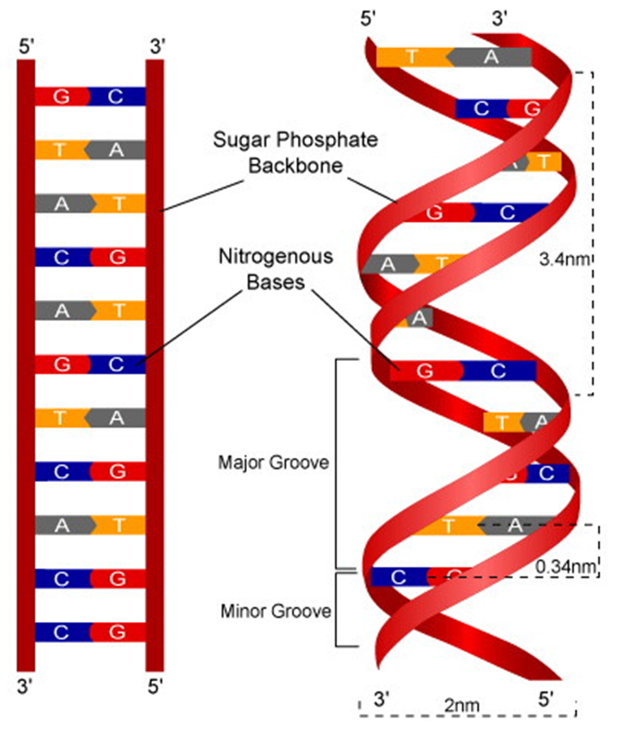
DEOXYRIBONUCLEIC ACID DNA
Composed of nucleotides joined together
Double stranded
Twisted into helix – looks like spiral staircase
2 strands run anti-parallel
Sides of "staircase" = alternating sugar & phosphate groups
Steps of "staircase" = complementary base pairs
Adenine pairs with thymine
Guanine pairs with cytosine

Slide 17
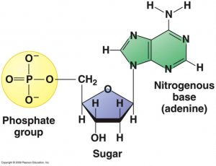
NUCLEOTIDE STRUCTURE
5 carbon sugar – deoxyribose
Carbons numbered 1' to 5'
"Deoxy-" = missing an oxygen (at 2' carbon) when compared to ribose
Base bonded to 1' carbon of sugar
4 different bases possible – adenine, thymine, cytosine, guanine
Phosphate group bonded to 5' carbon of sugar

Slide 18
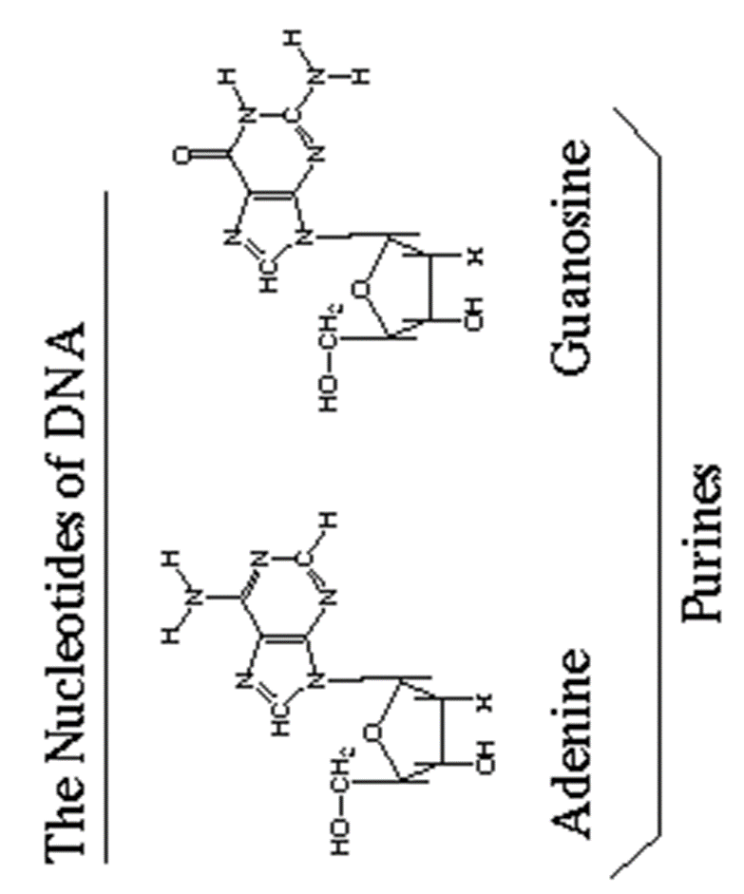
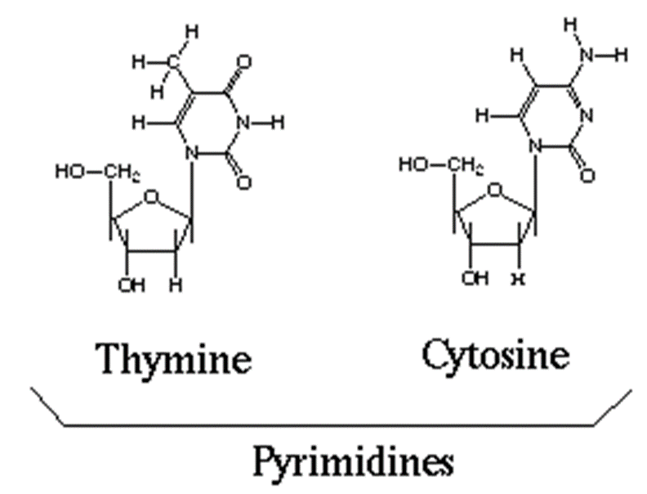
DNA NUCLEOTIDES

Slide 19
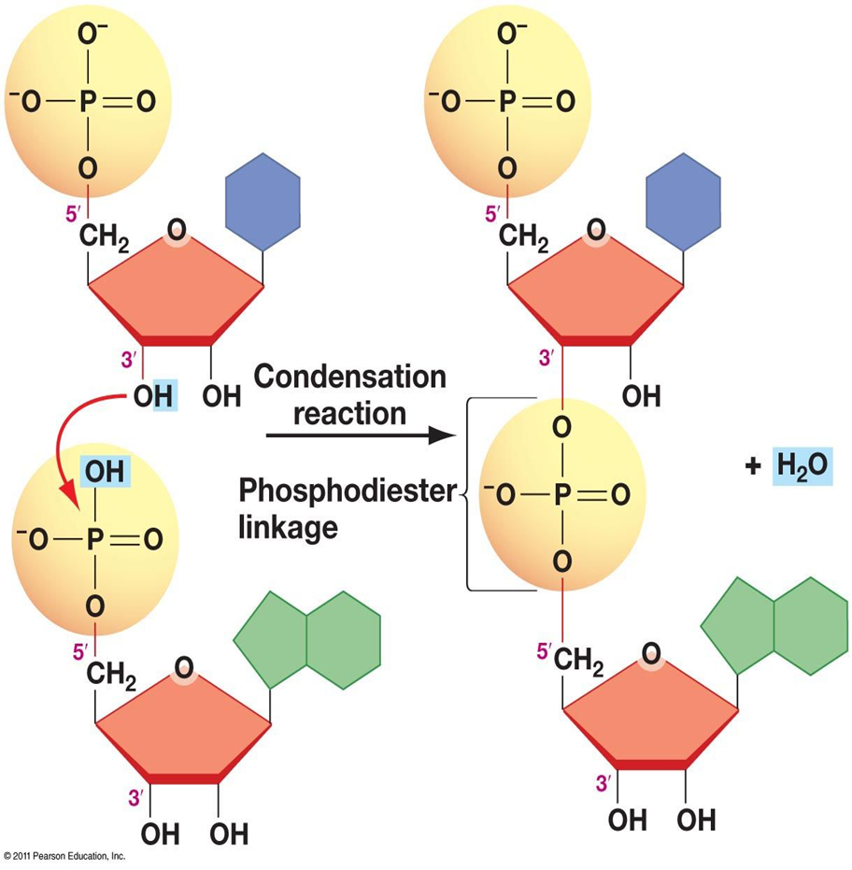
NUCLEOTIDE BONDING
Nucleotides are joined by phosphodiester bonds.
“Phospho” = phosphate group
“Diester” = two sugars
Condensation/Dehydration reaction – removal of water joins nucleotides

Slide 20
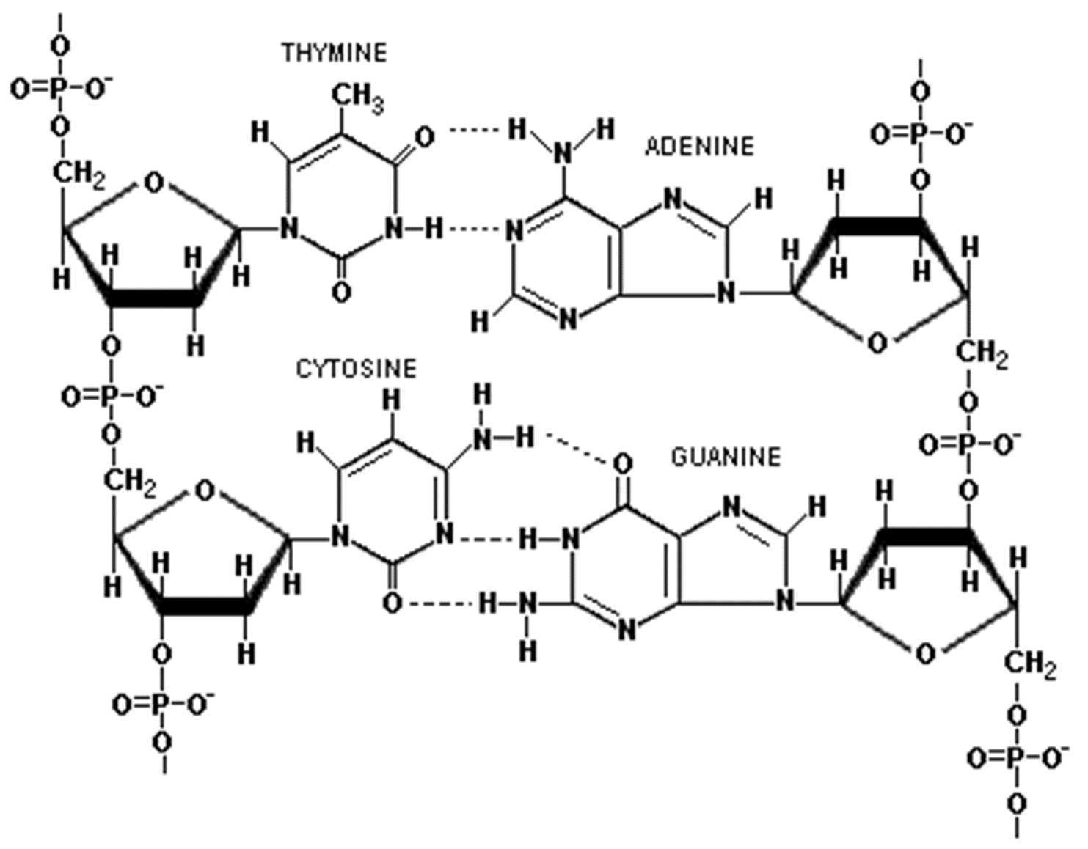
HYDROGEN BONDING
Attraction between complementary base pairs
Creates “steps” of DNA staircase
Holds opposite sides of DNA together
Must be broken before DNA can be replicated

Slide 21
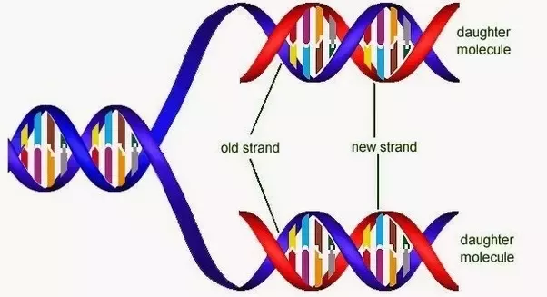
DNA REPLICATION
Process by which cell copies its DNA
Necessary to make copy before division to ensure each new cell has copy of DNA
Semi-conservative process
Each strand of DNA is used as template for new DNA
Resulting DNA strands consist of one original strand and one new strand - "conserves" the information of original DNA strand

Slide 22
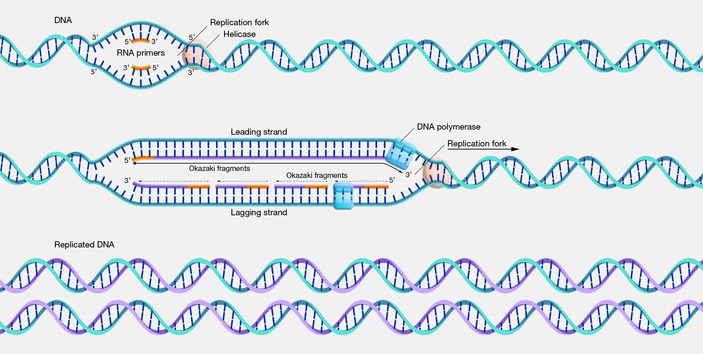
DNA REPLICATION - OVERVIEW

Slide 23
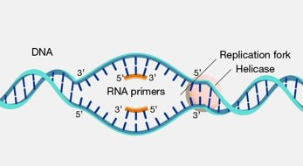
DNA REPLICATION INITIATION
Helicase breaks H bonds between base pairs. DNA strands separate. Replication fork is formed.
Single stranded binding proteins bind to DNA, prevents overcoiling and rebonding.
RNA Primase adds RNA primer in 5' to 3' direction.

Slide 24
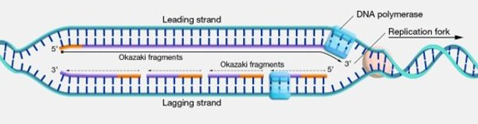
DNA REPLICATION ELONGATION
4. DNA Polymerase begins at RNA primer, creating new DNA by adding nucleotides in 5' to 3' direction.
Leading strand – built in same direction as helicase, continuous, no breaks
Lagging strand – built in opposite direction as helicase, not continuous, numerous breaks
Okazaki fragments – short sections of DNA formed on lagging strand

Slide 25
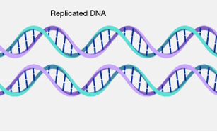
DNA REPLICATION TERMINATION
5. DNA Polymerase destroys RNA primers, replacing with DNA nucleotides.
6. Ligase seals gaps between fragments.
7. Two new DNA molecules are formed, each with one original strand and one new strand.

Slide 26
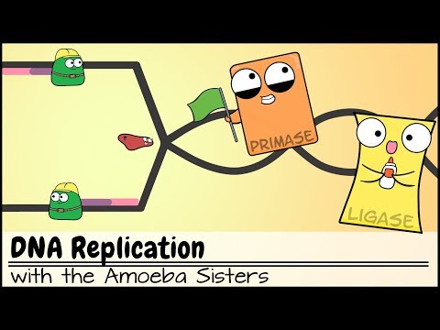
VIDEO – DNA REPLICATION

Slide 27
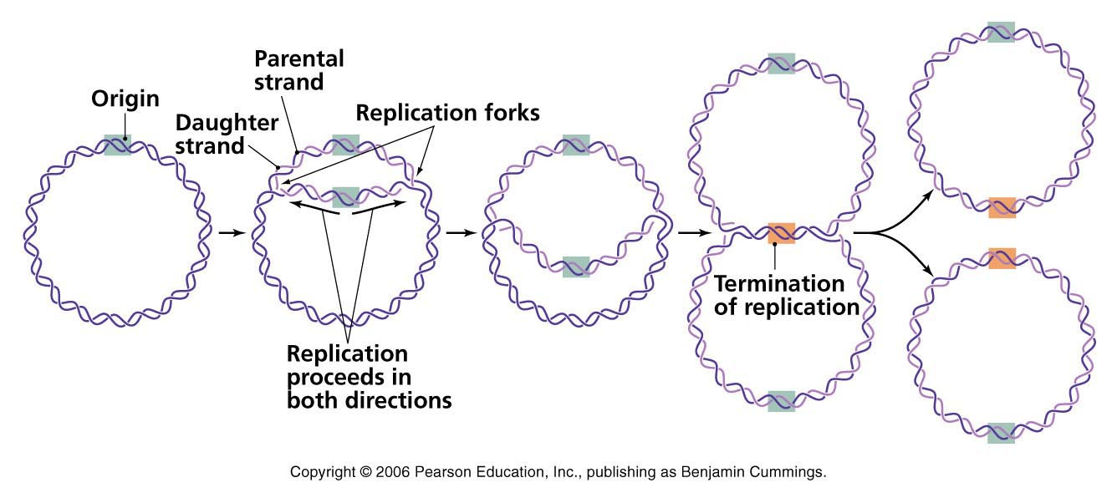
DNA REPLICATION BACTERIAL CELL
Circular chromosome
Semi-conservative process
Begins at "Origin of Replication"
Proceeds in both directions around chromosome
Two replication forks meet – termination

Slide 28
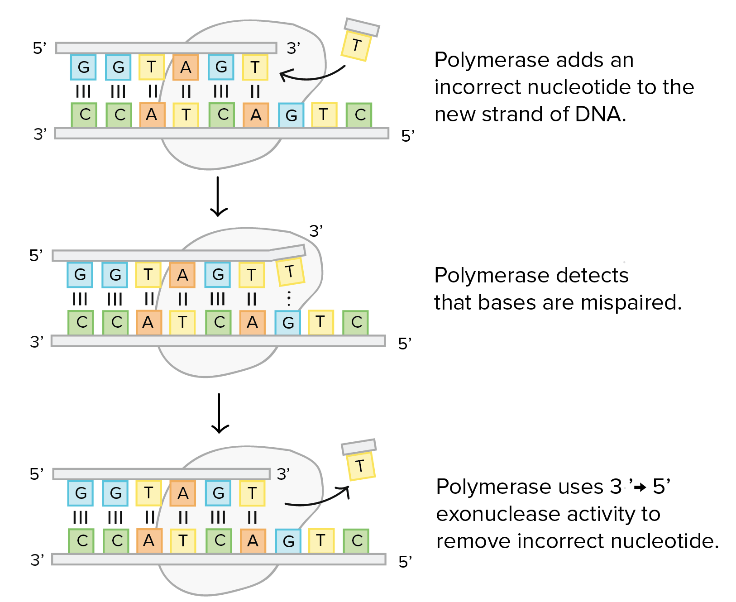
DNA PROOFREADING
DNA Polymerase corrects mismatched base pairs as they occur
Removes incorrect nucleotide
Replaces with correct nucleotide
Not perfect – 1 in 100 errors not corrected

Slide 29
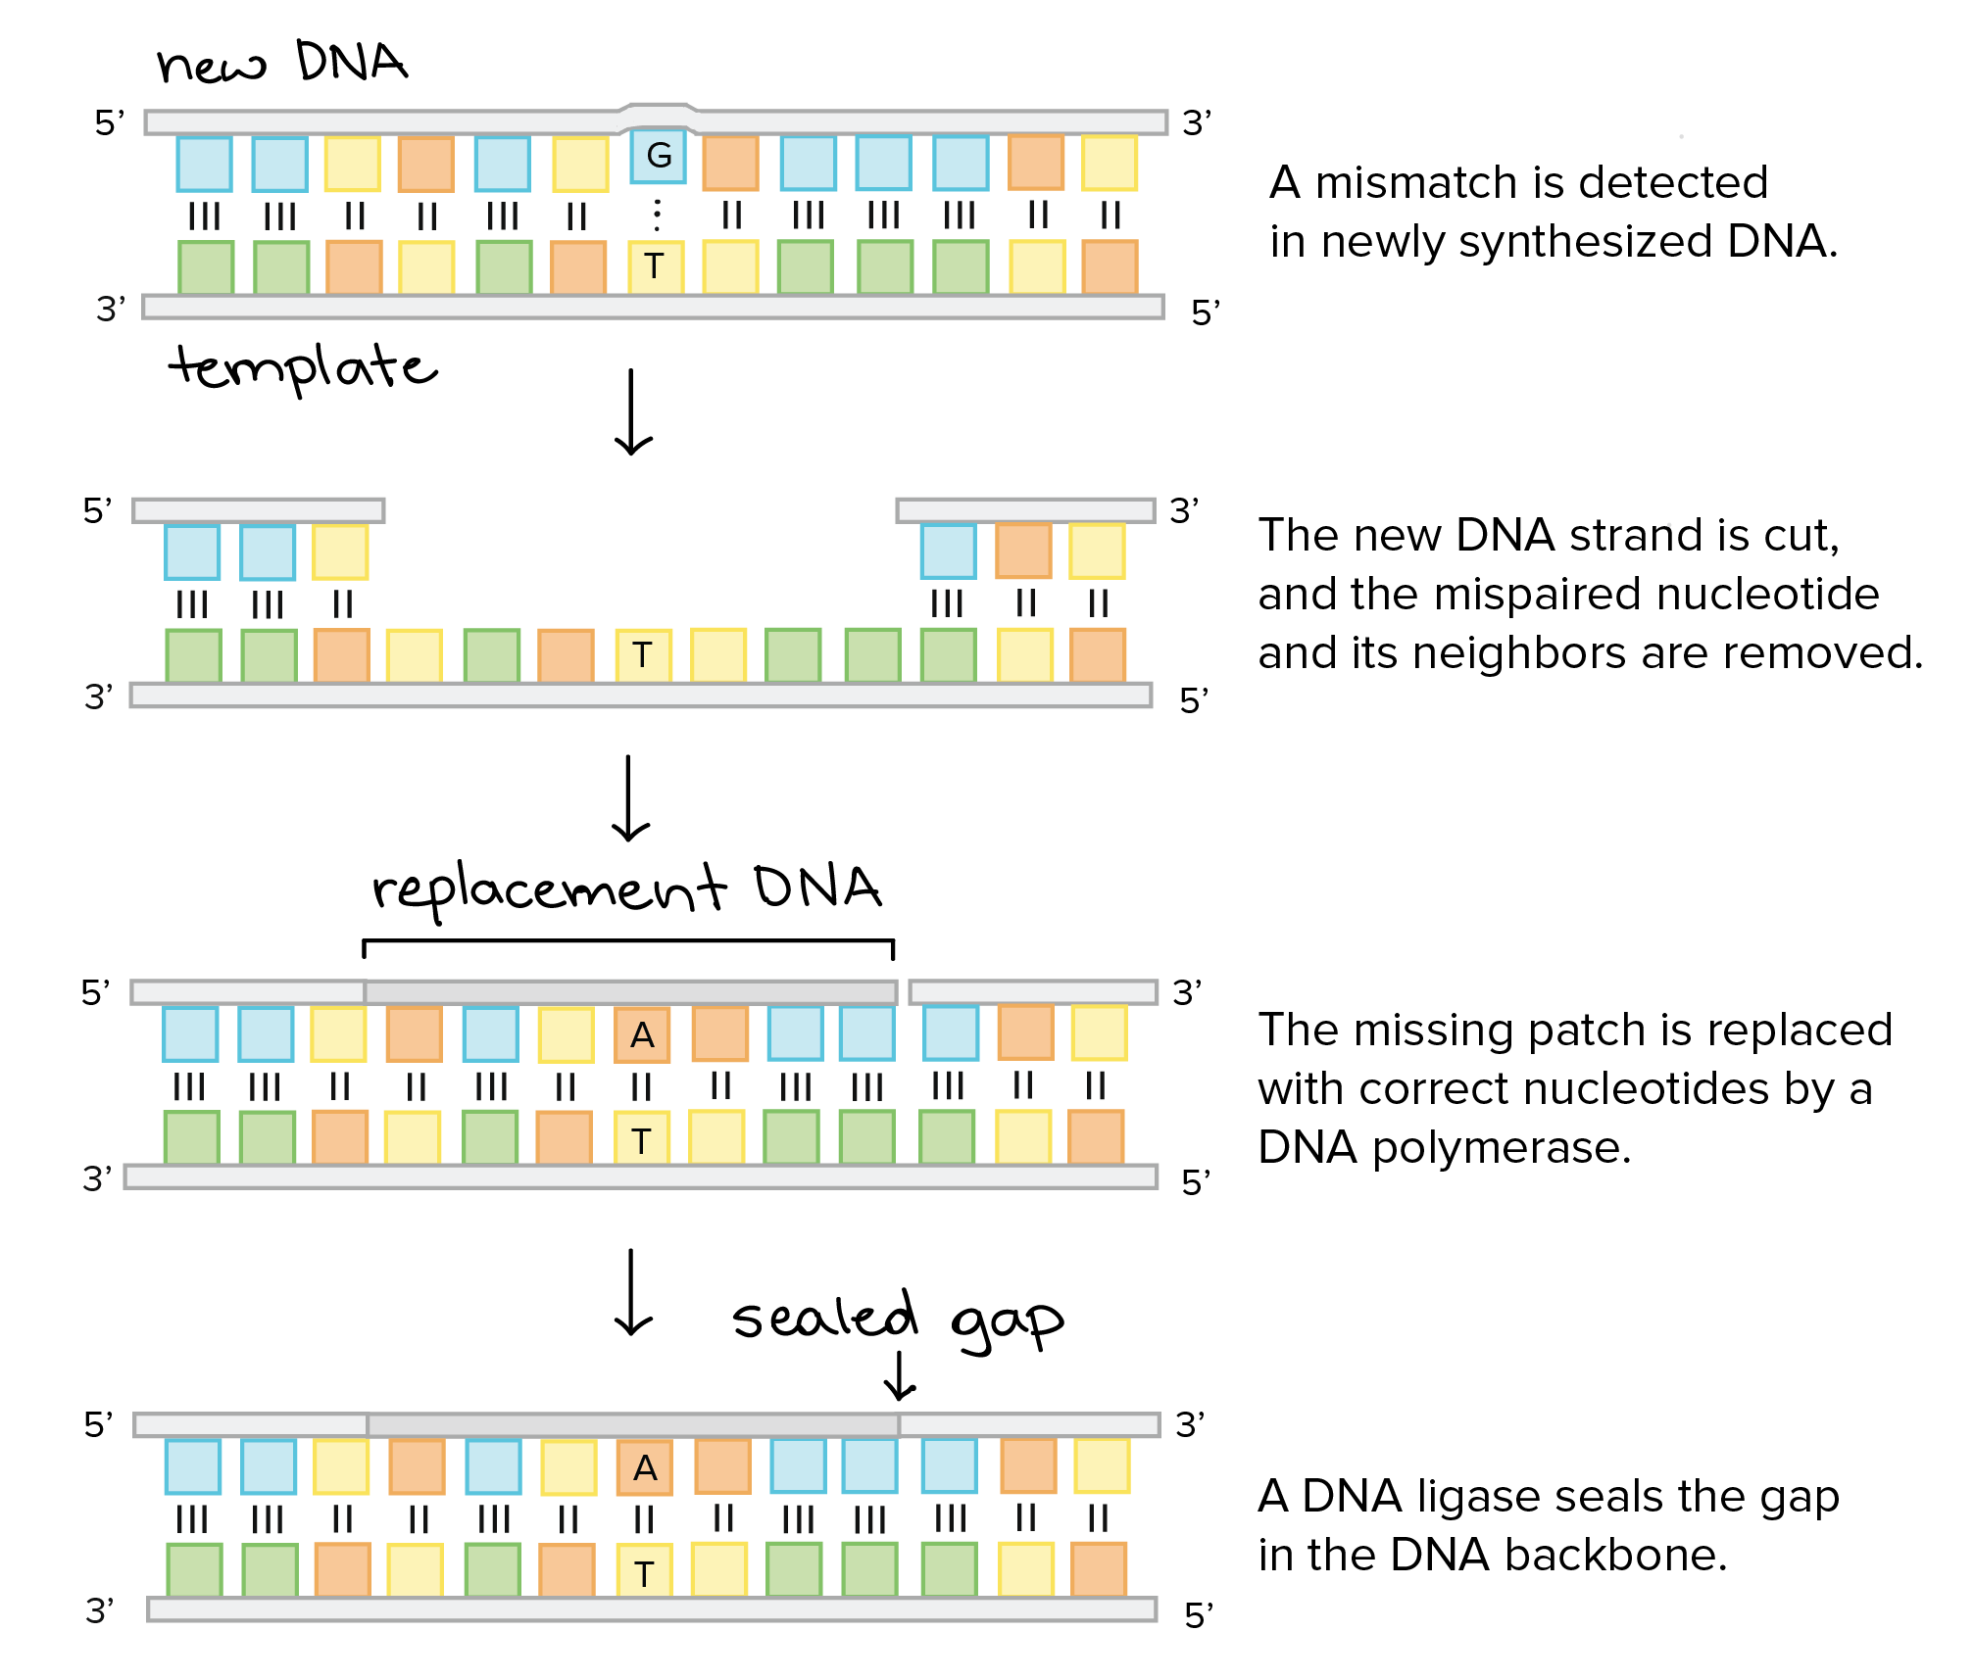
DNA REPAIR
Errors not corrected during proofreading
DNA portion with error is removed
DNA polymerase replaces with correct nucleotides
Ligase seals gaps
Not perfect – 1 in 1,000,000 errors not corrected

Slide 30
DNA ERRORS
DAMAGE
Abnormalities in DNA
Can be recognized by enzymes
Can be repaired if original strand is unaffected
Can lead to mutations
MUTATIONS
Change in nucleotide sequence
Not recognized by enzymes
Replicated when DNA is replicated
Cannot be repaired once passed on
Can cause alterations in protein structure and function

Slide 31
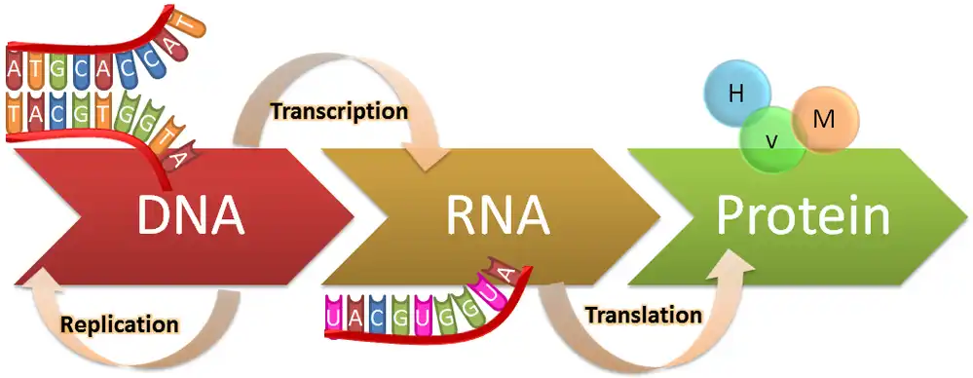
CENTRAL DOGMA OF MOLECULAR BIOLOGY

Slide 32
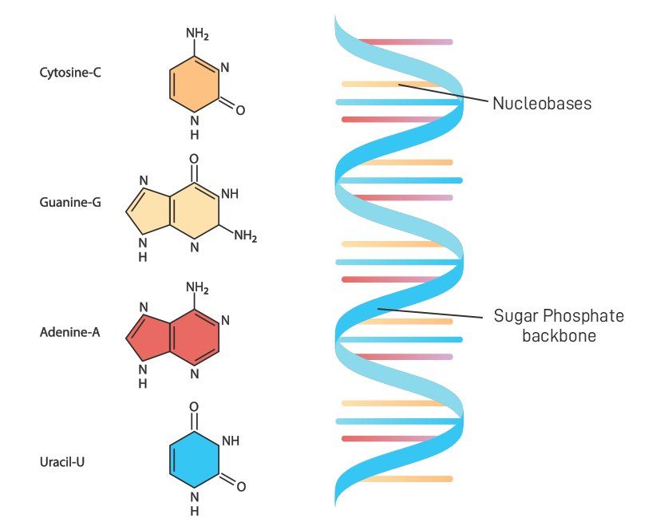
RIBONUCLEIC ACID RNA
Single stranded
Contains ribose sugar
3 bases similar to DNA
Adenine
Cytosine
Guanine
1 base differs from DNA
Uracil – replaces Thymine
Genetic messenger (mRNA) – carries info from nucleus to ribosomes

Slide 33
TRANSCRIPTION
3 Steps:
Initiation – RNA polymerase binds to promoter sequence on DNA (start of gene)
Elongation – RNA Polymerase builds RNA in 5' to 3' direction using complementary RNA nucleotides
Termination – RNA Polymerase reaches termination sequence on DNA (end of gene), transcription ends
Process of copying DNA segment into messenger RNA (mRNA)
Only copies one gene at a time

Slide 34
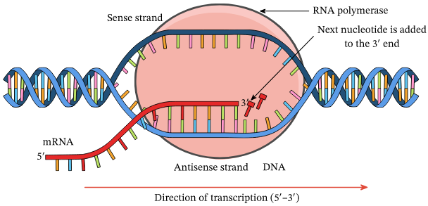
TRANSCRIPTION

Slide 35
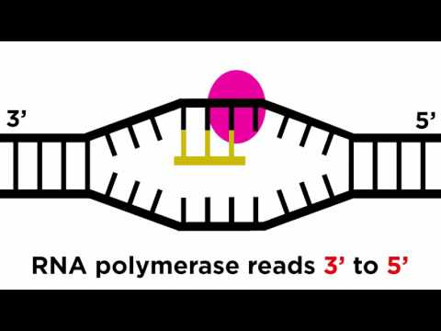
VIDEO - TRANSCRIPTION
Start at 1:17
Stop at 3:15

Slide 36
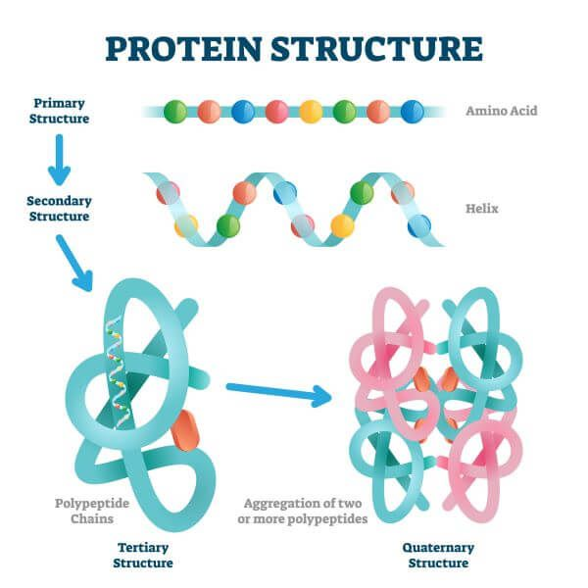
PROTEIN REVIEW
4 levels of structures
Level 1 – polypeptide chain
Level 2 – polypeptide chain bends or coils
Level 3 – sheet or coil wraps around itself
Level 4 – multiple polypeptide chains bond together
Structure directly linked to protein function
Level 1 built by ribosomes

Slide 37
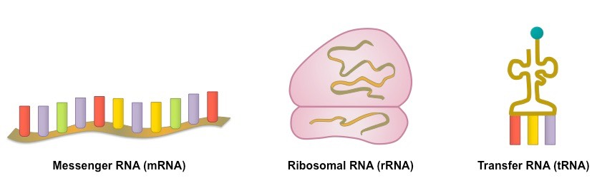
TRANSLATION
Process of building a protein from information found in mRNA
Key players:
mRNA – messenger RNA – carries instructions for building a specific protein
rRNA – ribosomal RNA – primary component of ribosomes, builds protein
tRNA – transfer RNA – decodes mRNA and matches to appropriate amino acid

Slide 38
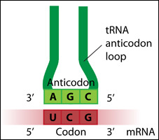
TRANSLATION
CODON
Located on mRNA
One codon = 3 nucleotides
Each codon codes for specific amino acid
ANTICODON
Located on tRNA
One anticodon = 3 nucleotides
Each anticodon is complement of codon on mRNA

Slide 39
TRANSLATION
3 Steps:
Initiation – tRNA attaches to start codon on mRNA, 2 subunits of rRNA join together
Elongation – mRNA reads one codon at a time, tRNA attaches to codon and adds amino acid to polypeptide chain
Termination – ribosome recognizes stop codon, rRNA units separate, translation ends

Slide 40
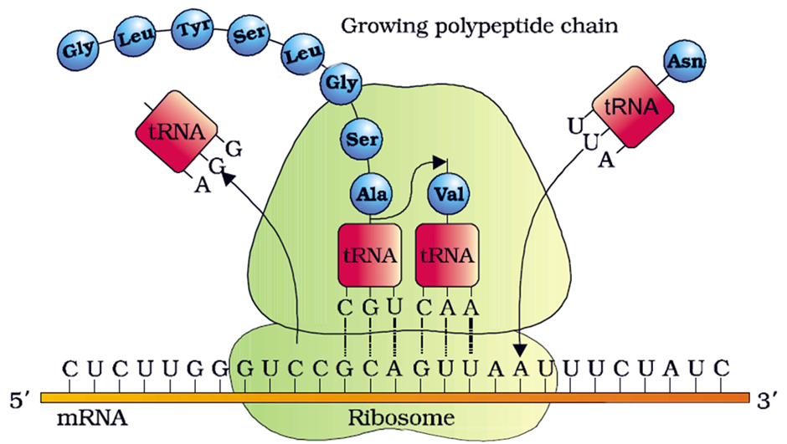
TRANSLATION

Slide 41
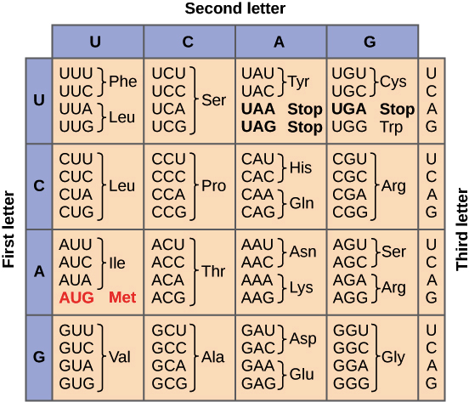
CODON CHART
Used to identify amino acids coded for within a segment of mRNA
How to use:
Transcribe DNA into mRNA
Locate start codon AUG – this will be the beginning of the protein
Break the rest of the mRNA segment into blocks of 3 nucleotides (codons)
For each codon, use the left side of the chart to match the first letter of the codon.
Use the top of the chart to match the second letter of the codon.
Use the right side of the chart to match the third letter of the codon.

Slide 42
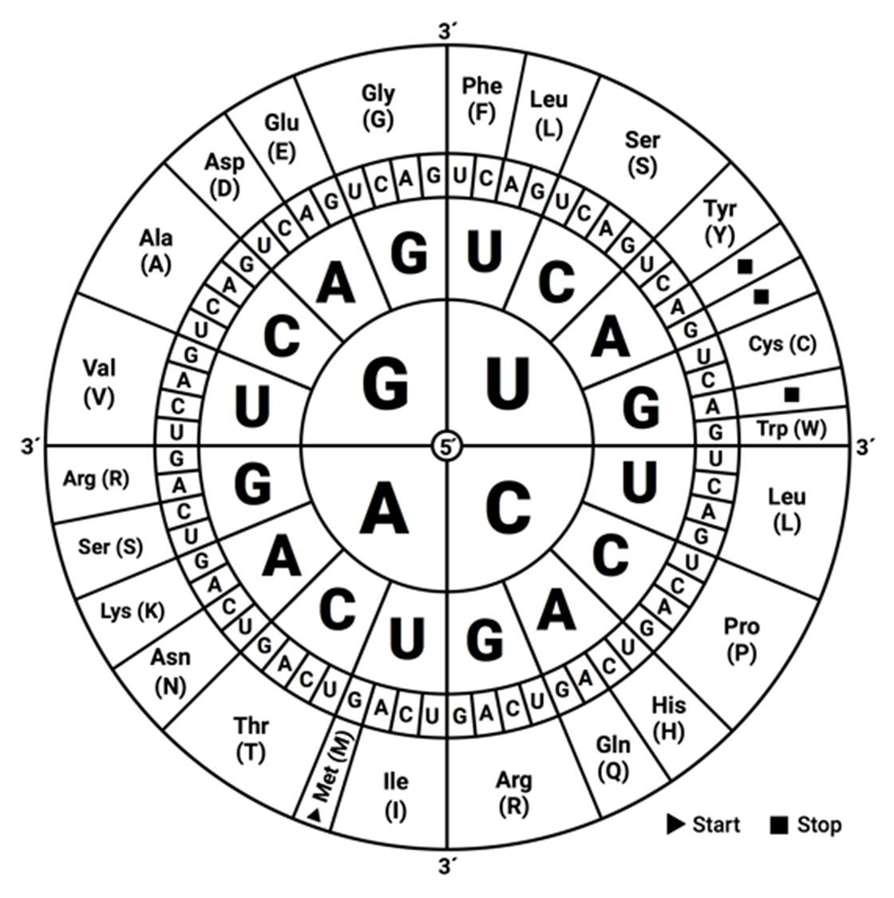
PRACTICE
CGA
UUU
AUG
UAA
GCC

Slide 43
MUTATIONS
TYPES
Point mutation – change in one nucleotide
Substitution – one nucleotide swapped for another nucleotide
Frameshift mutation – change in reading frame
Insertion – addition of extra nucleotide
Deletion – removal of nucleotide
Transposable mutation – change in order of codons
Transposon - "jumping genes" - swap places with another
Codon could be reversed (backwards)
EFFECTS
Silent mutation – no effect on protein
Missense mutation – results in different amino acid, changes polypeptide chain and possibly protein structure & function
Nonsense mutation – results in premature stop codon, creates short polypeptide chain affecting protein structure & function

Slide 44
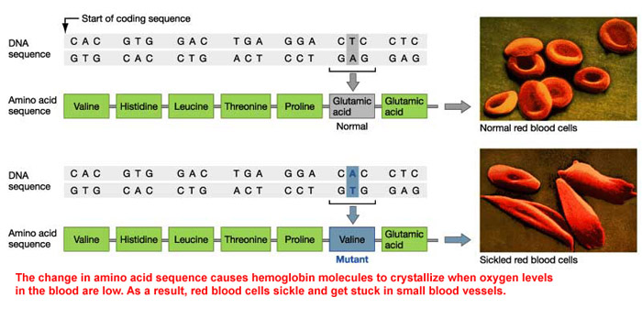
SICKLE CELL ANEMIA

Slide 45
CAUSES OF MUTATIONS
SPONTANEOUS
Occur naturally due to replication/transcription errors or transposons
Replication errors remain in 1:1,000,000,000 replications when proofreading or repairing fails
INDUCED
Occur when exposed to mutagen or carcinogen
Mutagen – chemical or physical agent capable of causing DNA mutation
Physical mutagens – radiation, xrays, viruses, bacteria, etc.
Environmental mutagens – UV light, air pollution, tobacco smoke, etc.
Carcinogens – causes mutation or promotes growth of mutated cells, leads to cancer

Slide 46
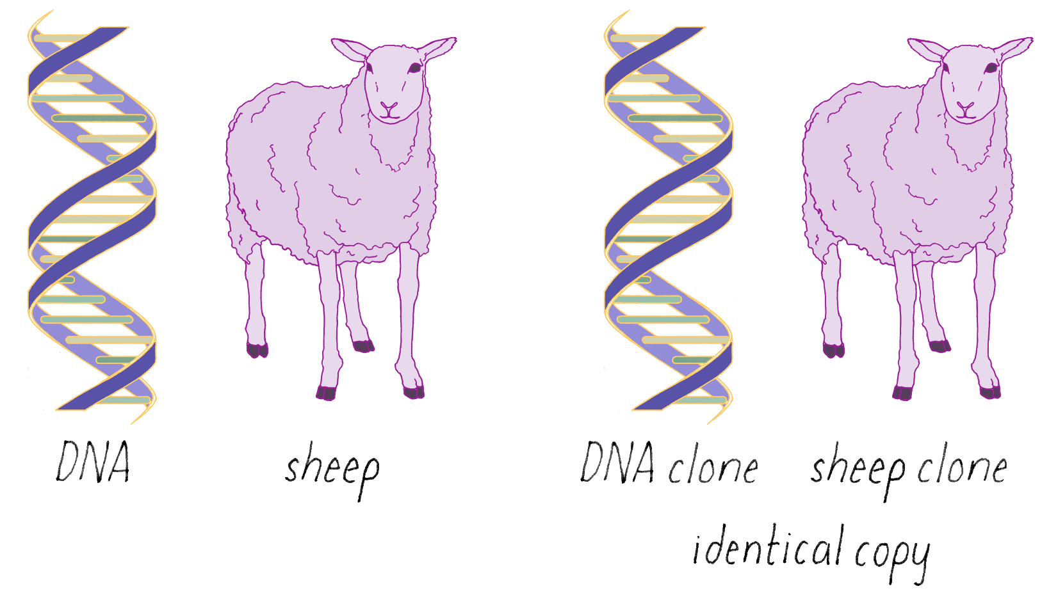
CLONING
Creation of an organism that is an exact genetic copy of another
Every DNA nucleotide is identical between the two organisms

Slide 47
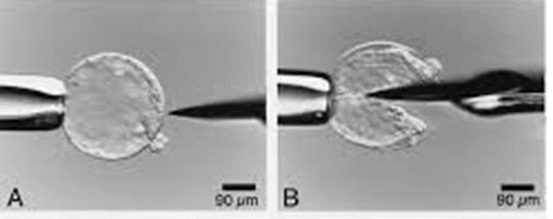
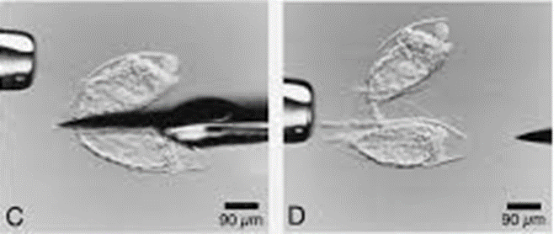
REPRODUCTIVE CLONING Used to produce new individual with identical DNA to living individual
ARTIFICIAL EMBRYO TWINNING
Manually separates young embryo into individual cells
Individual cells are allowed to divide & develop independently
Resulting embryos are placed in surrogate mother, carried to term, & delivered
Used to increase numbers for food production or of endangered species

Slide 48
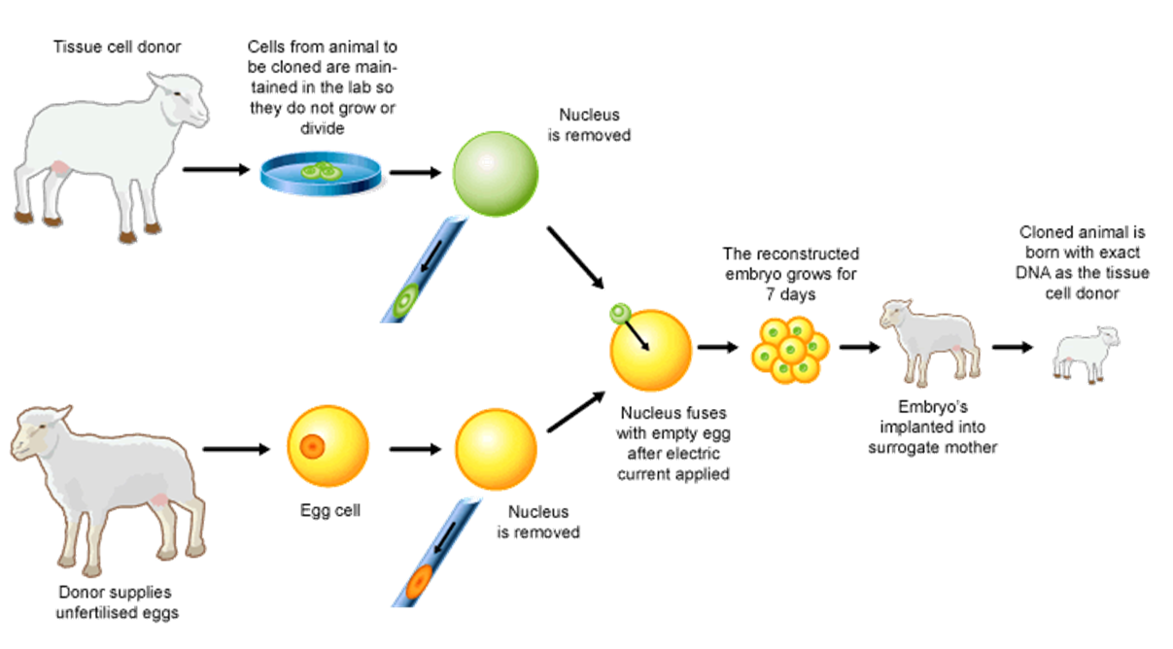
REPRODUCTIVE CLONING Used to produce new individual with identical DNA to living individual
SOMATIC CELL NUCLEAR TRANSFER
Nucleus of somatic (body) cell transferred to enucleated (nucleus removed) egg cell
The somatic nucleus "reprograms" egg cell to become zygote
Zygote divides & develops, placed in surrogate mother, carried to term, & delivered
Dolly the sheep was first successful cloning of a mammal through this method

Slide 49
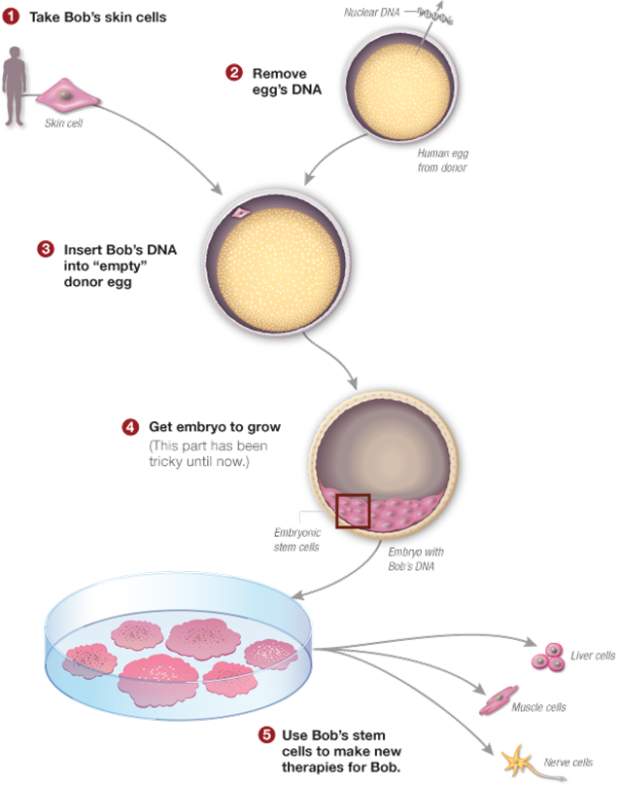
THERAPEUTIC CLONING
Refers to use of Somatic Cell Nuclear Transfer to reprogram somatic cells into stem cells
Stem cells – undifferentiated cells with potential to develop into many different types of cells
Used in treatment of degenerative diseases, traumatic injuries, or genetically predisposed conditions

Slide 50
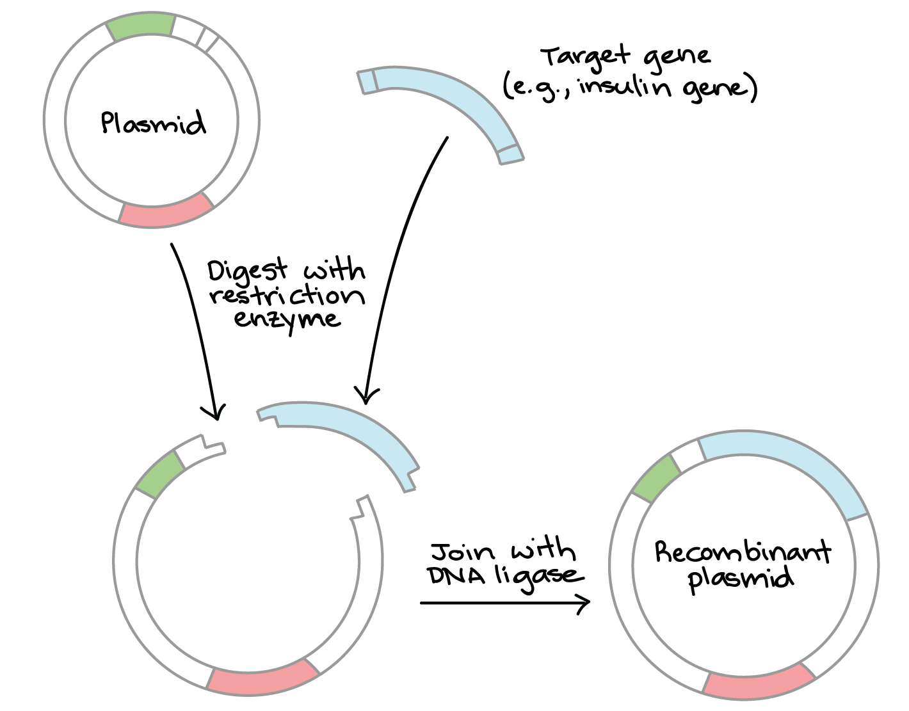
PLASMID CLONING
Plasmid – additional piece of DNA in bacterial cells
Target gene cut from DNA & inserted into bacterial plasmid
Bacteria replicate plasmid (& target gene), induced to produce protein
Most commonly used technique in molecular biology research

Slide 51
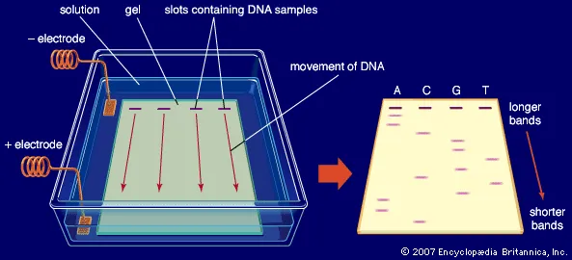
GEL ELECTROPHORESIS
Laboratory method to separate mixtures of DNA, RNA, or protein by size
DNA has overall negative charge so it is attracted to positive charge

Slide 52
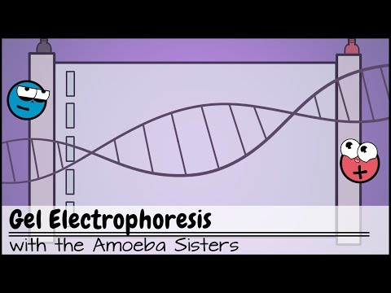
Jump to 1:42

Slide 53
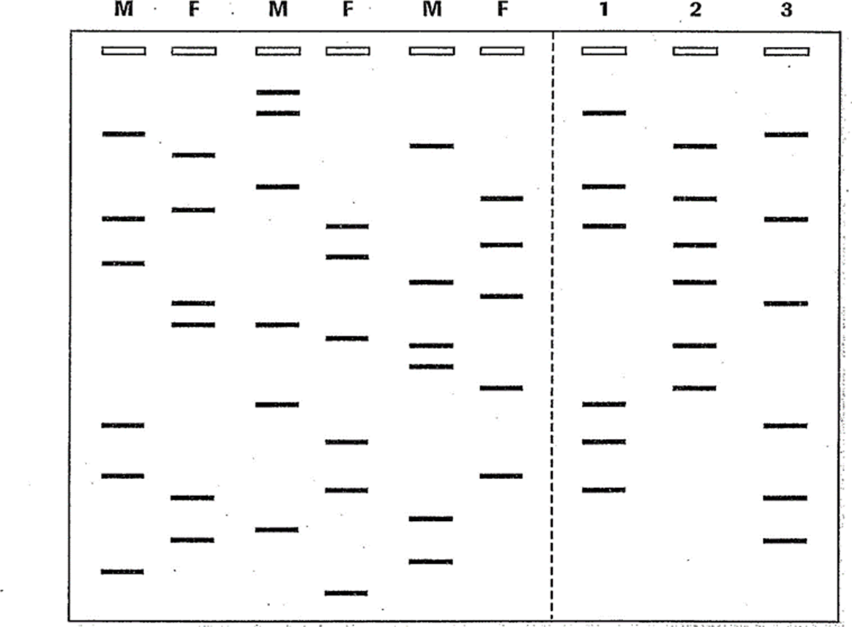
DNA FINGERPRINTING PRACTICE
COUPLES
A
B
C
INFANTS
Using the banding patterns, determine which couple (A, B, C) are the parents of each infant (1, 2, 3).
For each infant band, identify which parent shares the same segment of DNA.

